Slide 1
Biographic Movie Analysis
Vishalakshi Arumugam
Web Scrapping Project
DA 6223

Slide 2
Where the Data Comes from?
IMDB Movies with Biographic Genre
Scraped all the movies listed
Scraped the below fields
Movie Name
Year
Genre
Director
Rating
Meta score
Number of Votes
Runtime

Slide 3
Goals:
Do from Scratch
Most popular Year With more Number of Biographic movies
How the Movies Ranked based on User Rating, Number of votes and Metascore
All time Favorite Biographic Movies
Directors with more number of Biographic Movies

Slide 4
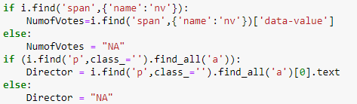
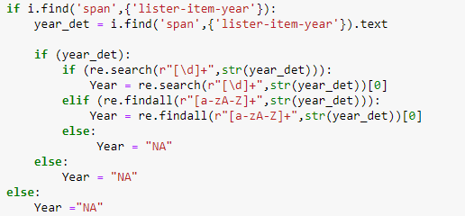
Challenges Faced During Web scraping
Getting the Nested HTML Tag Values
Using Regular Expression To get the Exact Data

Slide 5
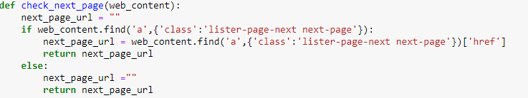
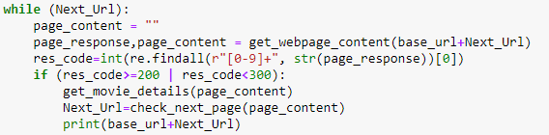
Challenges –cont.…..
Getting the Next page Url and looping through all pages

Slide 6
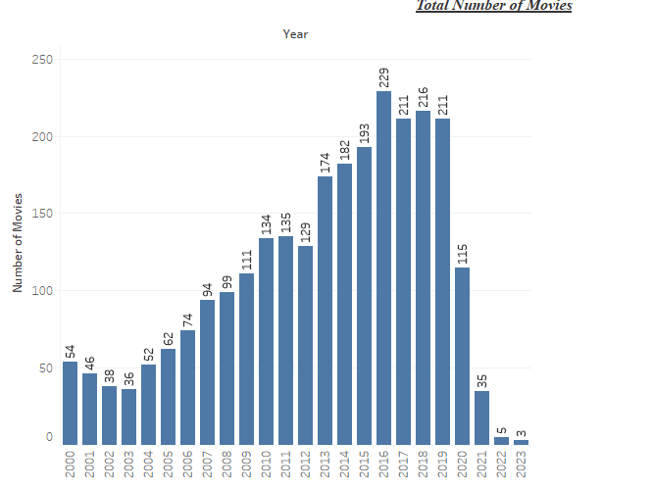
Movies By Year

Slide 7
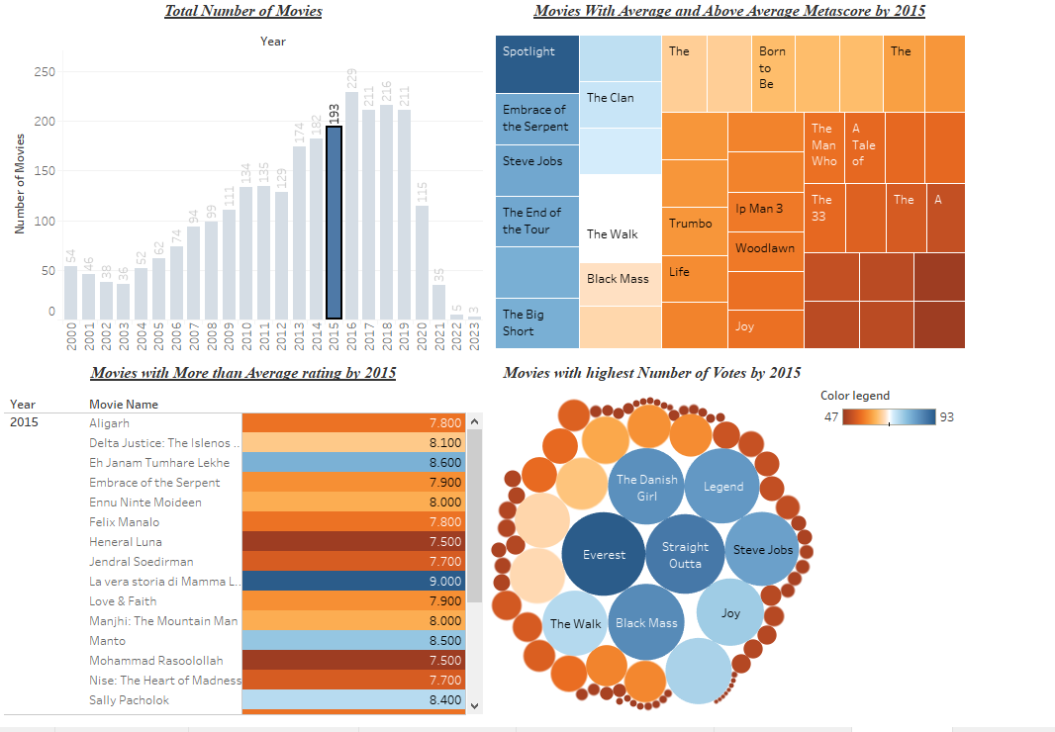
Movies Comparison by Various Measures

Slide 8
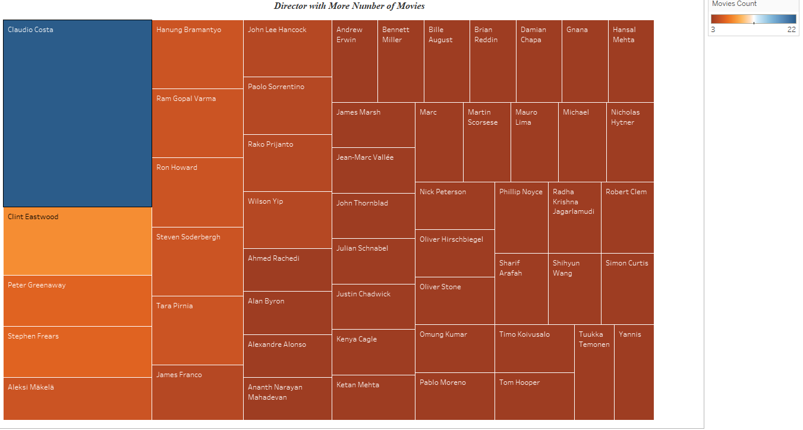
Directors with more Number of Biographic Movies

Slide 9
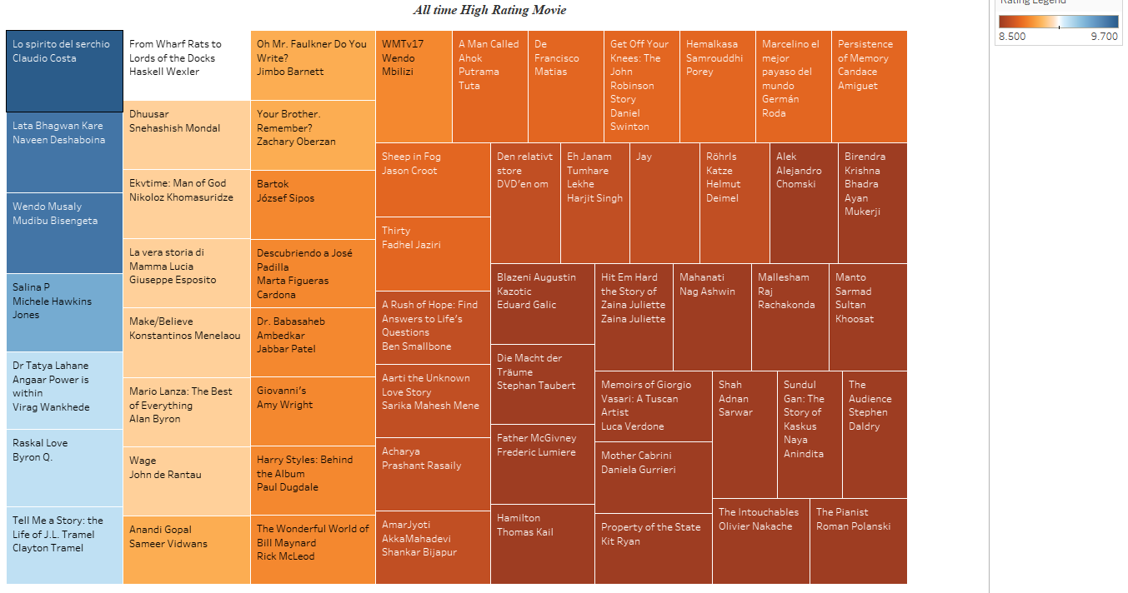
All Time High Rating Movies

Slide 10
Future Enhancement
User Review for all the Biographic Movies
Sentimental Analysis using Natural language Processing

Slide 11
Thank You

